Slide 1
Lead Score Case Study
Submitted by :
Varun Kumar

Slide 2
Lead Score Case Study for X Education
Problem Statement :
X Education sells online courses to industry professionals. We markets its courses on several websites and search engines like Google.
Once these people land on the website, they might browse the courses or fill up a form for the course or watch some videos. When these people fill up a form providing their email address or phone number, they are classified to be a lead. Moreover, We also gets leads through past referrals.
Once these leads are acquired, employees from the sales team start making calls, writing emails, etc. Through this process, some of the leads get converted while most do not. The typical lead conversion rate at X education is around 30%.
Business Goal:
X Education needs help in selecting the most promising leads, i.e. the leads that are most likely to convert into paying customers.
We needs a model wherein you a lead score is assigned to each of the leads such that the customers with higher lead score have a higher conversion chance and the customers with lower lead score have a lower conversion chance.
The CEO, in particular, has given a ballpark of the target lead conversion rate to be around 80%.

Slide 3
Strategy
Data cleaning and data manipulation.
Check and handle duplicate data.
Check and handle NA values and missing values.
Drop columns, if it contains large amount of missing values and not useful for the analysis.
Imputation of the values, if necessary.
Check and handle outliers in data.
EDA
Univariate data analysis: value count, distribution of variable etc.
Bivariate data analysis: correlation coefficients and pattern between the variables etc.
Feature Scaling & Dummy Variables and encoding of the data.
Classification technique: logistic regression used for the model making and prediction.
Evaluating the model by using different metrics - Specificity and Sensitivity or Precision and Recall
Validation of the model.
Model presentation.
Applying the best model in Test data based on the Sensitivity and Specificity Metrics.
Conclusions

Slide 4
Problem solving methodology
Data Sourcing , Cleaning
and Preparation
Read the Data from Source
Convert data into clean format suitable for analysis
Remove duplicate data
Outlier Treatment
Exploratory Data Analysis
Feature Standardization.
Feature Scaling and Splitting Train and Test Sets
Feature Scaling of Numeric data.
Splitting data into train and test set
Result
Determine the lead score and check if target final predictions amounts to 80% conversion rate.
Evaluate the final prediction on the test set using cut off threshold from sensitivity and specificity metrics
Model Building
Feature Selection using RFE
Determine the optimal model
using Logistic Regression
Calculate various metrics like accuracy, sensitivity, specificity, precision and recall and evaluate the model.

Slide 5
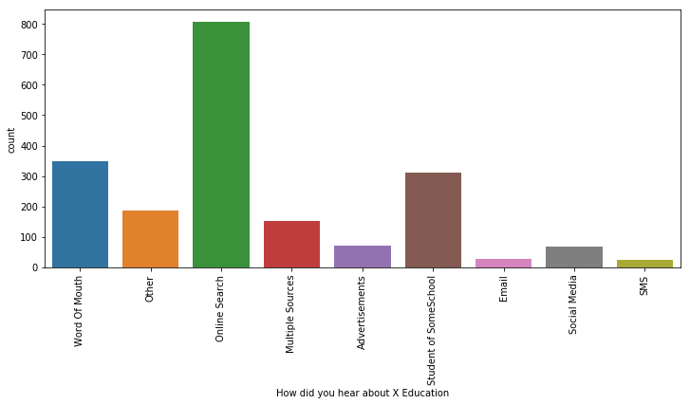
How did you hear about X Education

Slide 6
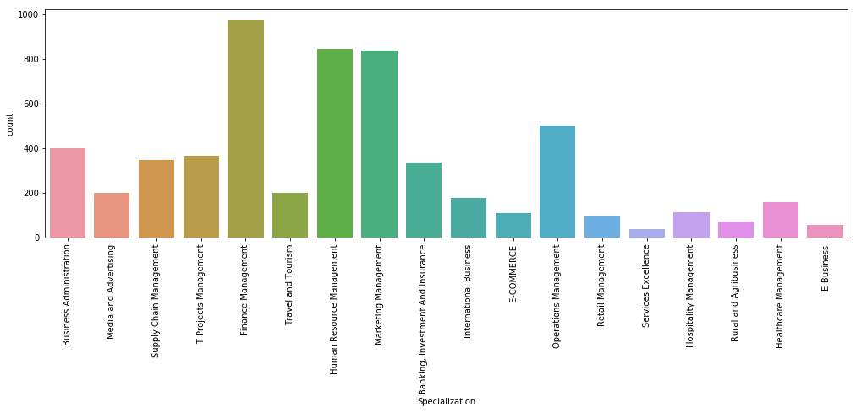
Specialization

Slide 7
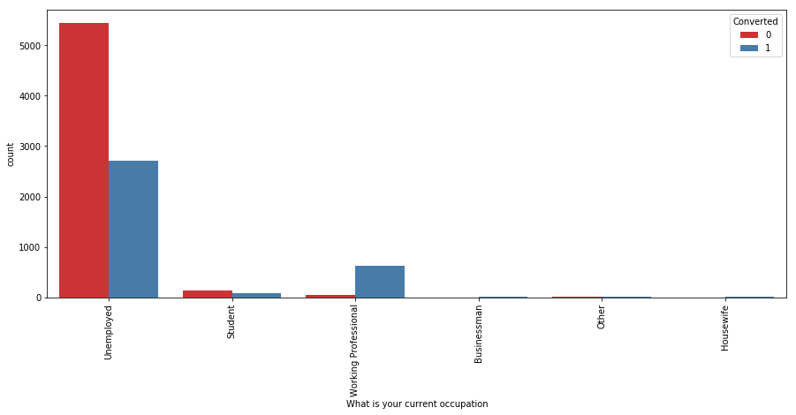
What is your current occupation
Unemployed leads are the most in numbers but has around 30-35% conversion rate.

Slide 8
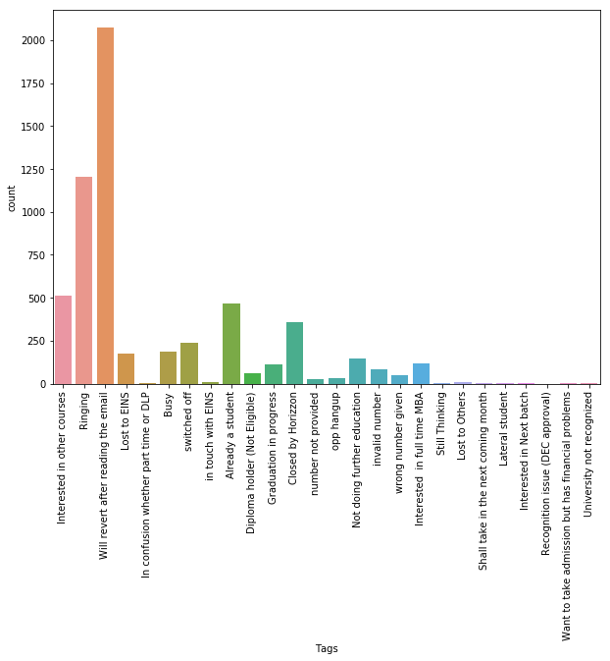
Tags

Slide 9
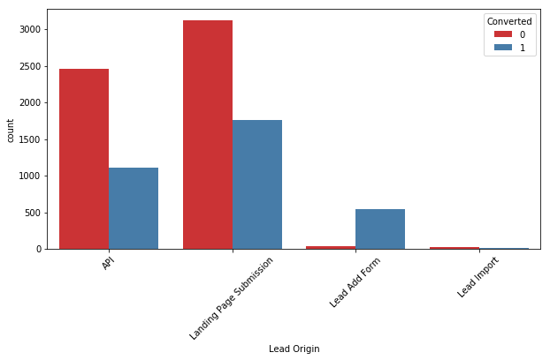
Lead Origin
In Lead Origin, maximum conversion happened from Landing Page Submission

Slide 10
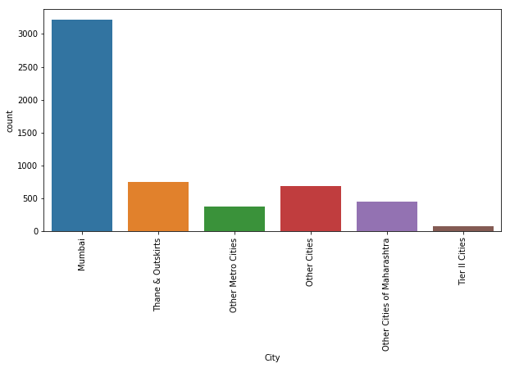
City
Major conversion has happened from Mumbai.

Slide 11
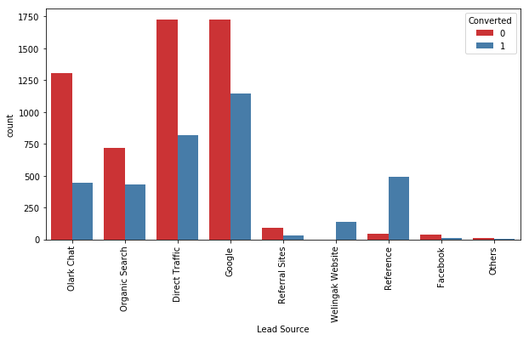
Lead Source
Google and Direct traffic generates maximum number of leads.

Slide 12
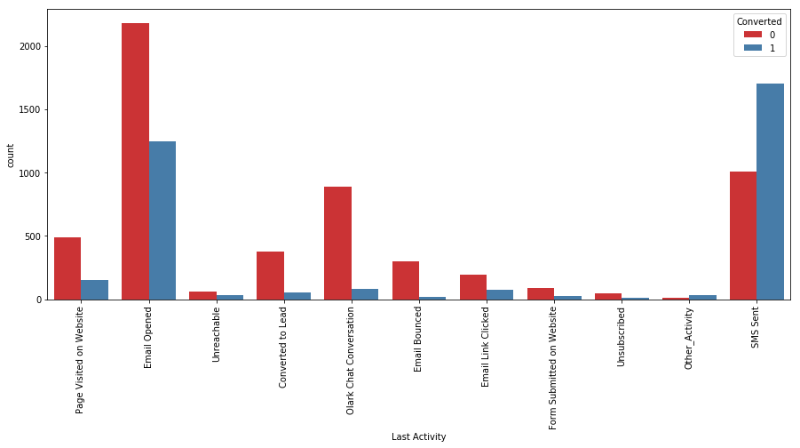
Last Activity
Last Activity value of SMS Sent' had more conversion.

Slide 13
Data Conversion
Numerical Variables are Normalized
Dummy Variables are created for object type variables
Total Rows for Analysis: 9074
Total Columns for Analysis: 69

Slide 14
Variables Impacting the Conversion Rate
Do Not Email
Total Visits
Total Time Spent On Website
Lead Origin – Lead Page Submission
Lead Origin – Lead Add Form
Lead Source - Olark Chat
Last Source – Welingak Website
Last Activity – Email Bounced
Last Activity – Not Sure
Last Activity – Olark Chat Conversation
Last Activity – SMS Sent
Current Occupation – No Information
Current Occupation – Working Professional
Last Notable Activity – Had a Phone Conversation
Last Notable Activity – Unreachable

Slide 15
Model Building
Splitting the Data into Training and Testing Sets
The first basic step for regression is performing a train-test split, we have chosen 70:30 ratio.
Use RFE for Feature Selection
Running RFE with 15 variables as output
Building Model by removing the variable whose p- value is greater than 0.05 and VIF value is greater than 5
Predictions on test data set
Overall accuracy 81%

Slide 16
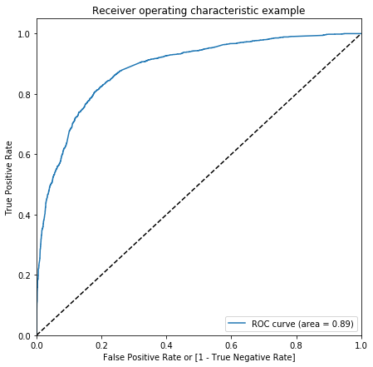
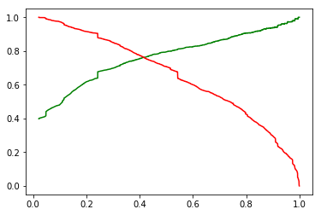
ROC curve and Precision and Recall
The graph depicts an optimal cut off of 0.42 based on Precision and Recall
Finding optimal cut off point
optimal cutt off probability is that where we get balanced sensitivity and specificity.

Slide 17
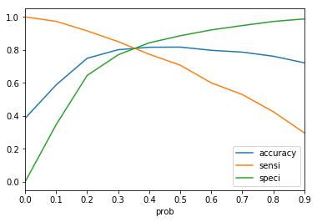
Model Evaluation - Sensitivity and Specificity on Train Data Set
The graph depicts an optimal cut off of 0.34 based on Accuracy, Sensitivity and Specificity
Confusion Matrix
3459
446
716
1730
Accuracy - 81%
Sensitivity - 70 %
Specificity - 88 %
False Positive Rate - 11 %
Positive Predictive Value - 79 %
Positive Predictive Value – 83 %

Slide 18
Model Evaluation – Sensitivity and Specificity on Test Dataset
Confusion Matrix
1394
340
193
796
Accuracy - 80 %
Sensitivity - 80 %
Specificity - 80 %

Slide 19
Conclusion
It was found that the variables that mattered the most in the potential buyers are :
We should make calls to the leads coming from the lead sources "Welingak Websites" and "Reference" as these are more likely to get converted.
Wes should make calls to the leads who are the "working professionals" as they are more likely to get converted.
We should make calls to the leads who spent "more time on the websites" as these are more likely to get converted.
We should make calls to the leads coming from the lead sources "Olark Chat" as these are more likely to get converted.
We should make calls to the leads whose last activity was SMS Sent as they are more likely to get converted.
We should not make calls to the leads whose last activity was "Olark Chat Conversation" as they are not likely to get converted.
We should not make calls to the leads whose lead origin is "Landing Page Submission" as they are not likely to get converted.
We should not make calls to the leads whose Specialization was "Others" as they are not likely to get converted.
We should not make calls to the leads who chose the option of "Do not Email" as "yes" as they are not likely to get converted.
Keeping these in mind the X Education can flourish as they have a very high chance to get almost all the potential buyers to change their mind and buy their courses.

